Slide 1


Julian Carro Verdia
05/09/2023

Slide 2

Outline
Executive Summary
Introduction
Methodology
Results
Conclusion
Appendix

Slide 3
Executive Summary
Summary of methodologies:
Data collection from CVS, SQL and web (webscrapping).
Data wrangling: dealing with missing values, standardize values.
Exploratory Data Analysis (EDA):
Visualization methods like ploting scatter plots, bar charts, interactive charts.
Predictive analysis: Calssification.
Summary of all results
Success of mission based on mass, launch site, orbit, etc.
From 2013 to 202 the missions’ outcomes improved.

Slide 4
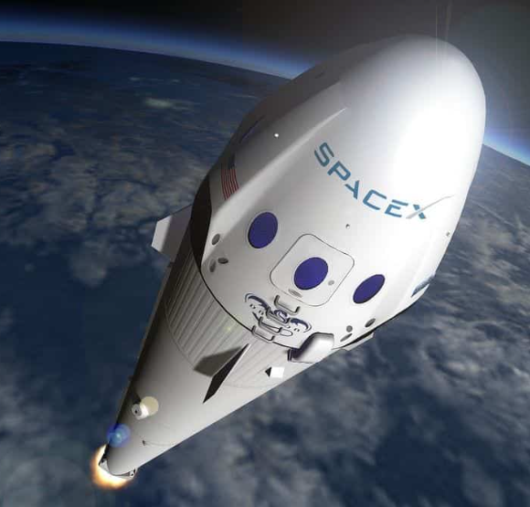
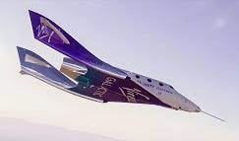
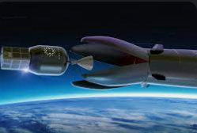

Introduction
The commercial space age is here, companies are making space travel affordable for everyone: Virgin Galactic is providing suborbital spaceflights. Rocket Lab is a small satellite provider. Blue Origin manufactures sub-orbital and orbital reusable rockets.
Perhaps the most successful is SpaceX.
SpaceX’s accomplishments: Sending spacecraft to the International Space Station.
Differentiation: rocket launches are relatively inexpensive (reuse the first stage). SpaceX advertises Falcon 9 rocket launches cost 62 million dollars; other providers cost upwards of 165 million dollars each. Therefore, if we can determine if the first stage will land, we can determine the cost of a launch. Spaces X’s Falcon 9 launch like regular rockets

Slide 5

Introduction
Study will be based on another company called “SpaceY” and below are the problems to find answers to:
Determine the price of each lunch.
Determine if SpaceX will reuse the first stage.
Determine if Falcon’s 9 second stage will land.
Explain how to choose an optimal launch site.

Slide 6

Section 1

Slide 7
Methodology
Executive Summary
Data collection methodology:
Data was collected from an API and loaded into coding environment (Jupyter Notebook) using Python language and several libraries such as Pandas, Numpy, Matplotlib, Seaborn, Sci-kit Learn, etc.
Perform data wrangling
Data was processed by the following general steps:
Identify percentage of missing values and fill them with mean values from rest of data.
Identify type of data for each occurrence.
Calculate several key information (i.e.: number of launches per site, number and occurrence of each orbit, etc.).

Slide 8
Methodology
Executive Summary
Perform exploratory data analysis (EDA) using visualization and SQL
Perform interactive visual analytics using Folium and Plotly Dash
Perform predictive analysis using classification models
Standarize data in order to get valuable insights.
Split data into training and testing subsets.
Train and evaluate accuracy of different classification models.

Slide 9
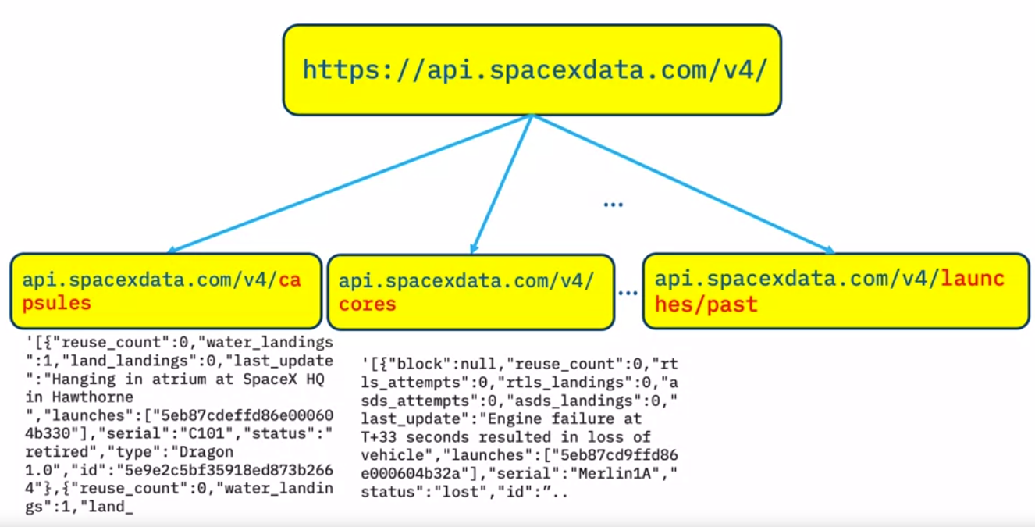
Data Collection
Data sets were collected via an endpoint or URL from REST API from SpaceX with launch data and from a specific web page via web-scrapping methods.
This endpoint is targeted via Python commands and loaded into the coding environment as a csv (comma separated values) file and then converted to a table that this language can manage.

Slide 10
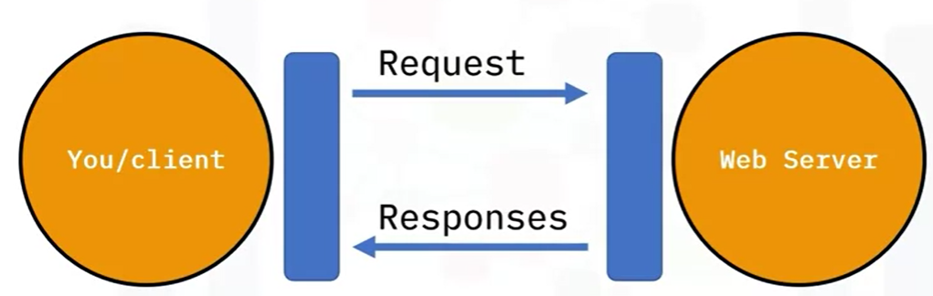
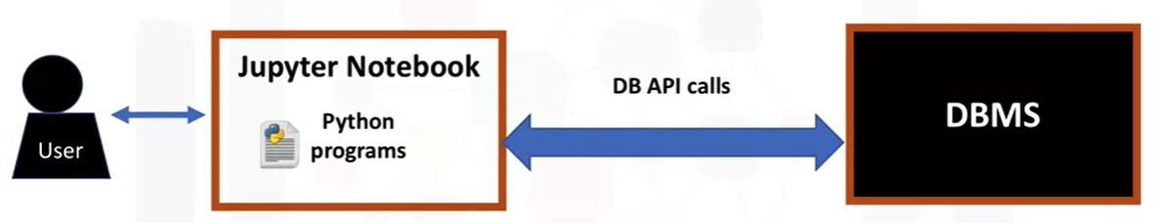
Data Collection – SpaceX API
Basically a series of communication standards and functions from libraries are structured and performed to retrieve data from a server or database into the Jupyter notebook where the data can be filtered, structured and calculations can be made.
Below is the link to the several steps for this study:
https://github.com/JulianCarroVerdia/IBM_Data_Science_Capstone_Presentation
Basic diagram of REST API call.
Basic diagram of database call.

Slide 11
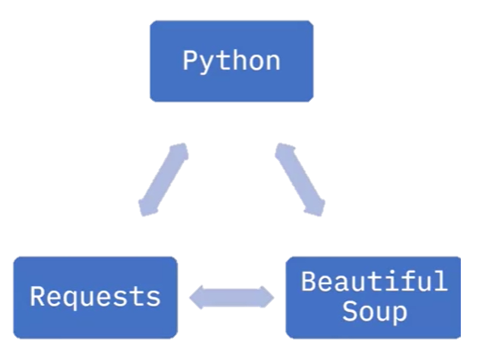
Data Collection - Scraping
Basically a series of communication standards and functions from libraries are structured and performed to retrieve data from a webpage (mainly tables) into the Jupyter notebook where the data can be filtered, structured and calculations can be made.
Below is the link to the several steps for this study:
https://github.com/JulianCarroVerdia/IBM_Data_Science_Capstone_Presentation

Slide 12
Data Wrangling
The main techniques for processing data were:
Replacing missing values in columns with mean of the rest of the data from that column.
Create a new column or list with binary values: 0 for one specific case and 1 for the rest of the cases.
Below is the link to the several steps for this study:
https://github.com/JulianCarroVerdia/IBM_Data_Science_Capstone_Presentation

Slide 13
EDA with Data Visualization
The following charts were used to see if there is a correlation between those variables and with that information, estimate outcomes:
Flight Number vs. Payload Mass in a scatter plot and overlay the outcome of the launch.
Flight Number vs. Launch Site in a scatter plot and overlay the outcome of the launch.
Payload Mass vs. Launch Site in a scatter plot and overlay the outcome of the launch.
Flight Number vs. Orbit in a scatter plot and overlay the outcome of the launch.
Payload Mass vs. Orbit in a scatter plot and overlay the outcome of the launch.
Success rate over the years in a line plot.
Below is the link to the several steps for this study:
https://github.com/JulianCarroVerdia/IBM_Data_Science_Capstone_Presentation

Slide 14
EDA with SQL
Below is the summary of the SQL queries performed:
select distinct "Launch_Site" from SPACEXTBL
SELECT * FROM SPACEXTBL WHERE "Launch_Site" LIKE 'CCA%' LIMIT 20
SELECT SUM("PAYLOAD_MASS__KG_") FROM SPACEXTBL WHERE Customer="NASA (CRS)“
SELECT AVG("PAYLOAD_MASS__KG_") FROM SPACEXTBL WHERE "Booster_Version" LIKE 'F9 v1.1%’
SELECT MIN(Date) FROM SPACEXTBL WHERE "Landing _Outcome"="Success (ground pad)“
SELECT distinct "Booster_Version" FROM SPACEXTBL WHERE "Landing _Outcome"="Success (drone ship)" AND "PAYLOAD_MASS__KG_">4000 AND "PAYLOAD_MASS__KG_"<6000
SELECT "Mission_Outcome", count(*) as total_outcomes FROM SPACEXTBL GROUP BY "Mission_Outcome“
SELECT DISTINCT"Booster_Version" FROM SPACEXTBL where (select MAX(PAYLOAD_MASS__KG_) from SPACEXTBL)

Slide 15
EDA with SQL
SELECT
CASE
WHEN substr(Date, 4, 2) = '01' THEN 'January'
WHEN substr(Date, 4, 2) = '02' THEN 'February'
WHEN substr(Date, 4, 2) = '03' THEN 'March'
WHEN substr(Date, 4, 2) = '04' THEN 'April'
WHEN substr(Date, 4, 2) = '05' THEN 'May'
WHEN substr(Date, 4, 2) = '06' THEN 'June'
WHEN substr(Date, 4, 2) = '07' THEN 'July'
WHEN substr(Date, 4, 2) = '08' THEN 'August'
WHEN substr(Date, 4, 2) = '09' THEN 'September'
WHEN substr(Date, 4, 2) = '10' THEN 'October’
WHEN substr(Date, 4, 2) = '11' THEN 'November'
WHEN substr(Date, 4, 2) = '12' THEN 'December'
END as month_name,

Slide 16
EDA with SQL
"Landing _Outcome",
"Booster_Version",
"Launch_Site"
FROM SPACEXTBL
WHERE substr(Date,7,4)='2015' AND "Landing _Outcome" LIKE '%Failure%' AND "Landing _Outcome" LIKE '%(drone ship)%’
SELECT * COUNT(*) as successful_landings
FROM SPACEXTBL
WHERE "Landing _Outcome" LIKE '%Success%’ AND "Date" BETWEEN '2010-06-04' AND '2017-03-20’
GROUP BY "Landing _Outcome“
ORDER BY successful_landings DESC
Below is the link to the several steps for this study:
https://github.com/JulianCarroVerdia/IBM_Data_Science_Capstone_Presentation

Slide 17
Build an Interactive Map with Folium
Below are the map objects such as markers, circles, lines, etc. created and added to the folium map:
Circle.
Marker.
Marker cluster.
Mouse position.
Polyline.
These objects were added in order to get insights from the map from the launches such as on a mouse position get the coordinates quickly, having straightforward information over the map like success launch, and having distance to main railroads, coastlines, etc.
Below is the link to the several steps for this study:
https://github.com/JulianCarroVerdia/IBM_Data_Science_Capstone_Presentation

Slide 18
Build a Dashboard with Plotly Dash
Below is the summary of the plots/graphs and interactions added to a dashboard:
Launch site drop-down input component.
Pie chart with a callback function based on selected site from drop-down input component.
Range slider to select payload mass (kg).
Scatter plot success vs. payload.
These graphs and interactions were added in order to enable stakeholders to explore and manipulate data in an interactive and real-time way. In this way, instead of presenting findings in static graphs, interactive data visualization can always tell a more appealing story.
Below is the link to the several steps for this study:
https://github.com/JulianCarroVerdia/IBM_Data_Science_Capstone_Presentation

Slide 19





Predictive Analysis (Classification)
Below is the summary building, evaluating, improvement and finding the best performing classification model:
Creation of Numpy array from selected columns for performing model testing and evaluation.
Standardize data for the range to be consistent.
Split dataset into test and train subsets.
Create objects for each model to be fitted and getting the accuracy for each one.
Below is the link to the several steps for this study:
https://github.com/JulianCarroVerdia/IBM_Data_Science_Capstone_Presentation
Dataset Split: test & train
Train & test
Model
Predict
Accuracy

Slide 20
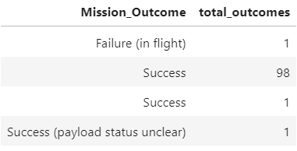
Results
By analizing the information in the exploratory data analysis, we se the following results:
As the flight number increases, the first stage is more likely to land successfully. The payload mass is also important; it seems the more massive the payload, the less likely the first stage will return.
For the VAFB-SLC launch site there are no rockets launched for heavy payload mass(greater than 10000) and generally speaking for this heavy payload mass there is a high success rate.
With heavy payloads the successful landing or positive landing rate are more for Polar,LEO and ISS. However for GTO we cannot distinguish this well as both positive landing rate and negative landing(unsuccessful mission) are both there here.
The success rate since 2013 kept increasing till 2020.
There was a very high success rate for all missions. See table →

Slide 21
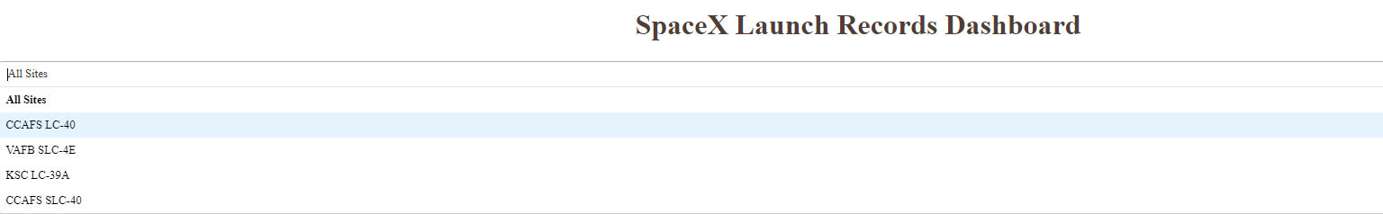
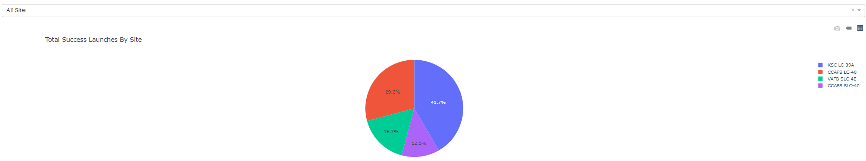
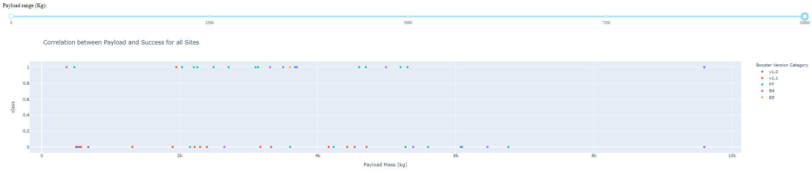
Results
Below are some screenshots from the interactive analytics:

Slide 22
Results
Below are the predictive analysis results:
Overall all methods testes for making a predictive analysis had a relatively high accuracy (>83%), except for the decision tree methos which perfomed with a 72% of accuracy.

Slide 23

Section 2

Slide 24
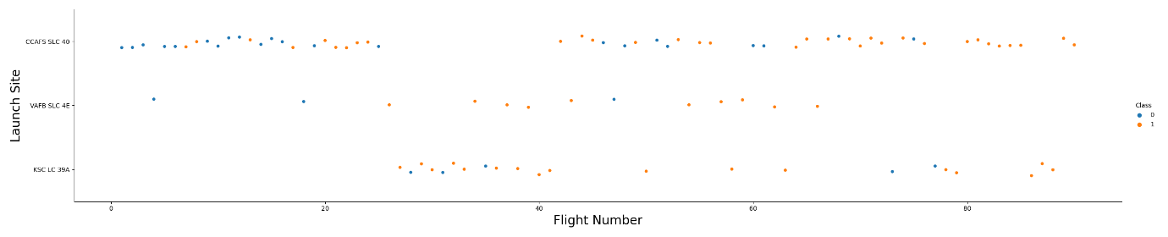
Flight Number vs. Launch Site
As it can be seen from the plot, the highest succes rate was from the launch site VAFB SLC 4E, followed by the KSC LC 39A and last CCAFS SLC 40. (Class 0 = failure, class 1 = success).

Slide 25
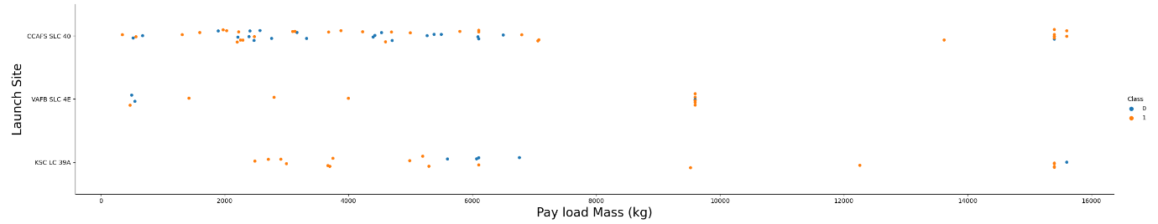
Payload vs. Launch Site
As it can be seen from the plot, generally speaking for big payload mass the success rate was bigger. (Class 0 = failure, class 1 = success).

Slide 26
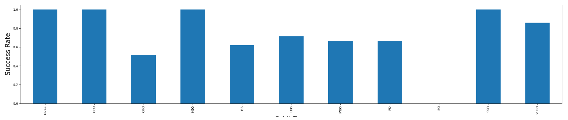
Success Rate vs. Orbit Type
As it can be seen from the plot, the orbits ES-L1, GFO, HEO. SSO and VLEO had the best success rate.

Slide 27
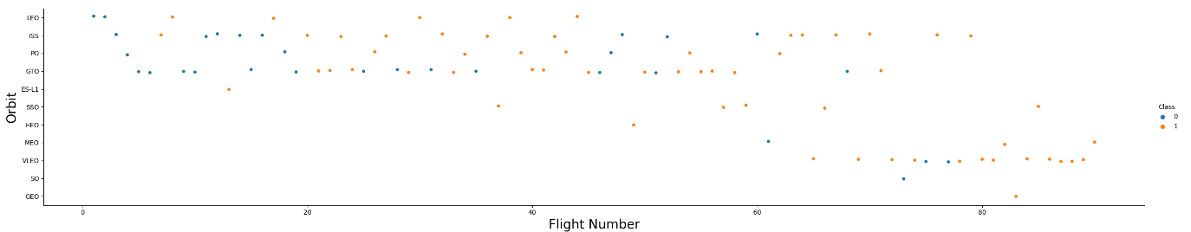
Flight Number vs. Orbit Type
As it can be seen from the plot, the LEO orbit the Success appears related to the number of flights; on the other hand, there seems to be no relationship between flight number when in GTO orbit.

Slide 28
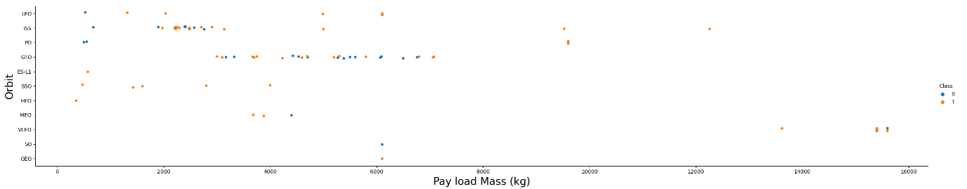
Payload vs. Orbit Type
As it can be seen from the plot, with heavy payloads the successful landing or positive landing rate are more for Polar,LEO and ISS. However for GTO we cannot distinguish this well as both positive landing rate and negative landing(unsuccessful mission) are both there here.

Slide 29
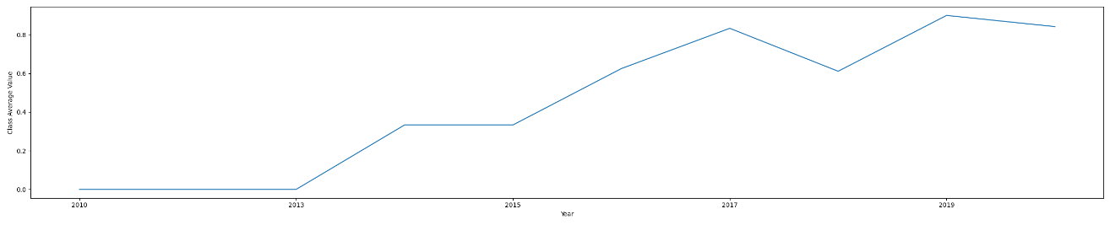
Launch Success Yearly Trend
As it can be seen from the plot, the success rate since 2013 kept increasing till 2020

Slide 30
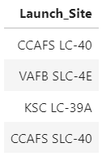
All Launch Site Names
The unique launch site in the space missions were retrieved with a SQL query to get these unique values, where the column Launch_Site is selected and a function named DISTINCT is applied to that column to return only unique values.
Query: %sql select distinct "Launch_Site" from SPACEXTBL

Slide 31
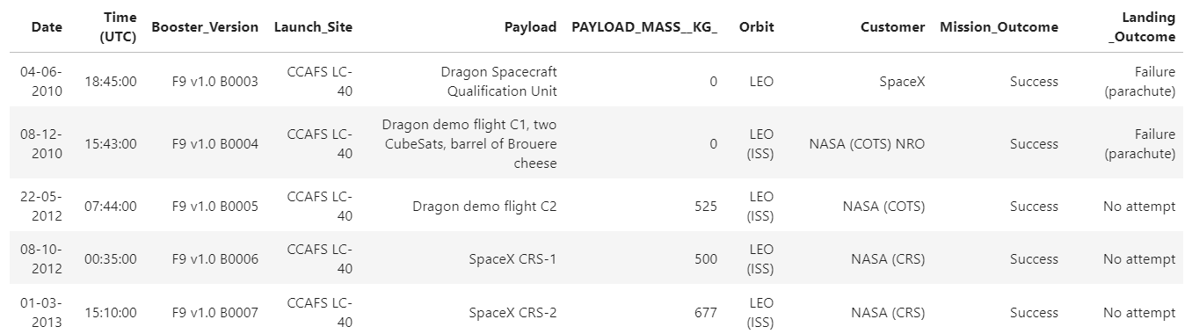
Launch Site Names Begin with 'CCA'
This query is used to retrieve all columns from SQL database and filter the column Launch_Site where the names begin with CCA by applying LIKE ‘CCA%’.
Query: %sql SELECT * FROM SPACEXTBL WHERE "Launch_Site" LIKE 'CCA%' LIMIT 5

Slide 32
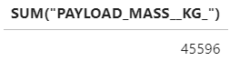
Total Payload Mass
The query uses SUM function to sum all values from the column PAYLOAD_MASS__KG_ where customer = NASA (CRS).
Query: %sql SELECT SUM("PAYLOAD_MASS__KG_") FROM SPACEXTBL WHERE Customer="NASA (CRS)"

Slide 33
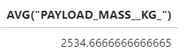
Average Payload Mass by F9 v1.1
The query uses AVG function to calculate de average of all values from the column PAYLOAD_MASS__KG_ where Booster_Version has the characters F9 v.1.1.
Query: %sql SELECT AVG("PAYLOAD_MASS__KG_") FROM SPACEXTBL WHERE "Booster_Version" LIKE 'F9 v1.1%'

Slide 34
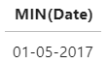
First Successful Ground Landing Date
The query uses MIN function to calculate de minimum vale from the column Date (first date) where Outcome = Success (ground pad).
Query: %sql SELECT MIN(Date) FROM SPACEXTBL WHERE "Landing _Outcome"="Success (ground pad)"

Slide 35
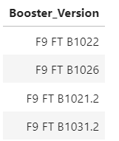
Successful Drone Ship Landing with Payload between 4000 and 6000
The query uses DISTINCT function retrieve unique values from Booster_Version column, with Landing_Outcome=Success and Payload between 4000 and 6000.
Query: %sql SELECT distinct "Booster_Version" FROM SPACEXTBL WHERE "Landing _Outcome"="Success (drone ship)" AND "PAYLOAD_MASS__KG_">4000 AND "PAYLOAD_MASS__KG_"<6000

Slide 36
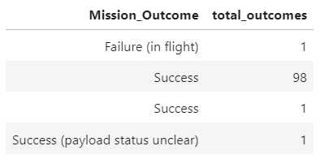
Total Number of Successful and Failure Mission Outcomes
The query selects the Mission outcome column and adds a column where it fills with the count of each case of mission outcome.
Query: %sql SELECT "Mission_Outcome", count(*) as total_outcomes FROM SPACEXTBL GROUP BY "Mission_Outcome"

Slide 37
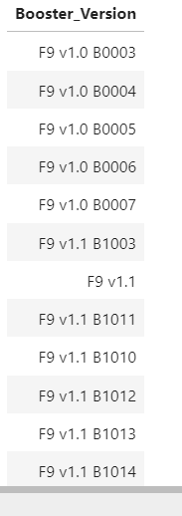
Boosters Carried Maximum Payload
The query selects unique values from Booster Version column and then uses a sub-query to select the max Payload Mass. (The table is very long, so a portion of it was included).
Query: %sql SELECT DISTINCT"Booster_Version" FROM SPACEXTBL where (select MAX(PAYLOAD_MASS__KG_) from SPACEXTBL)

Slide 38
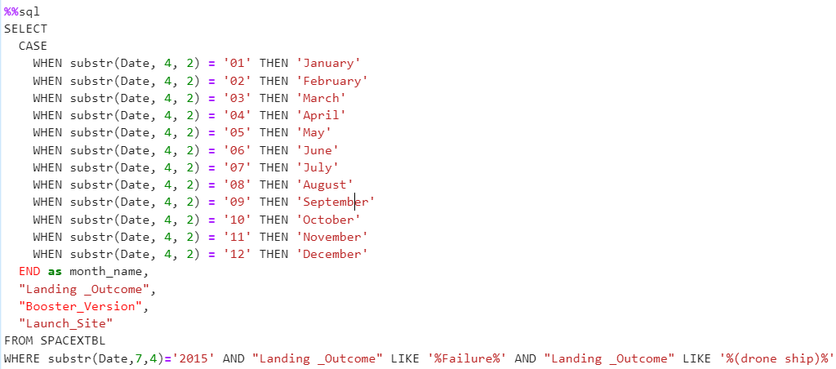
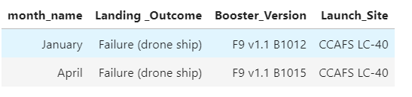
2015 Launch Records
The query uses a CASE function to translate number-type month date into letter-type month date, and filter: 2015 year failure launches, their bosster version and launch sites.
Query:

Slide 39
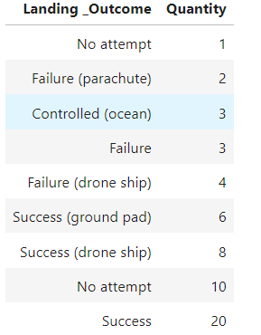
Rank Landing Outcomes Between 2010-06-04 and 2017-03-20
The query selects the Landing_Outcome column and counts the cases for the specified date range, groups it by Landing_Otume case and orders it by what was counted.
Query:%%sql
SELECT "Landing _Outcome", COUNT(*) as 'Quantity' FROM SPACEXTBL WHERE DATE BETWEEN '04-06-2010' AND '20-03-2017' GROUP BY "Landing _Outcome" ORDER BY "Quantity"

Slide 40

Section 3

Slide 41
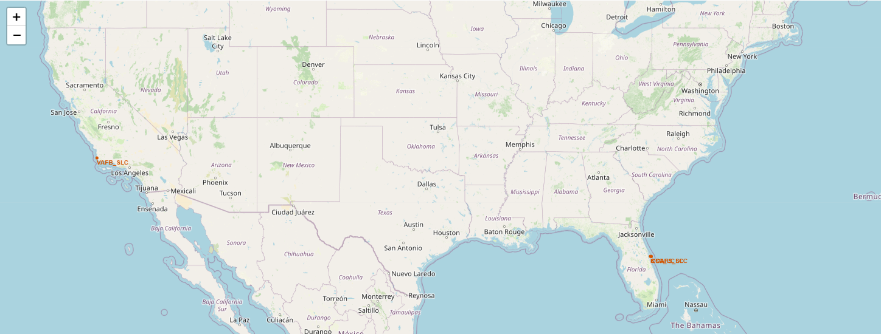
Map with markers and circles.
In the following screenshot of the map, a first layer of circles and markers were added to it. This is important in order to detect how close each launch site is from each other.

Slide 42
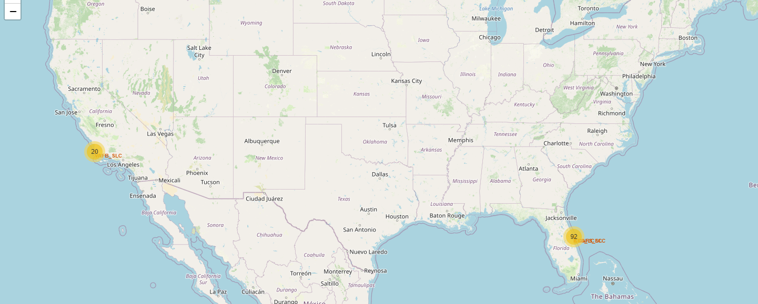
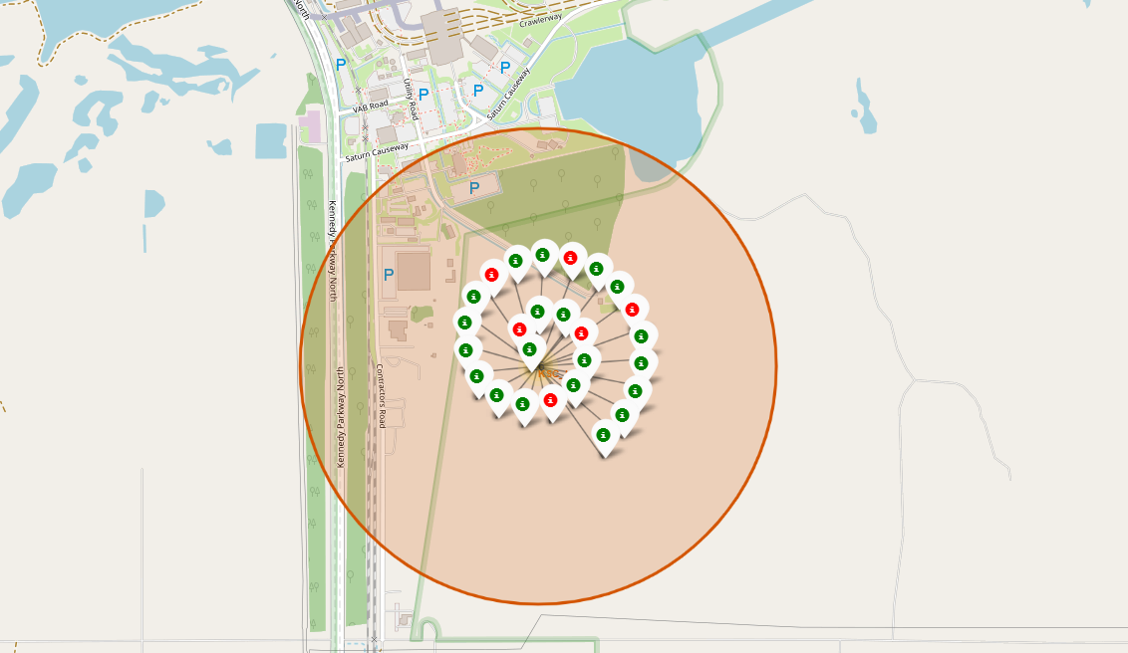
Map with markers, circles with success outcome.
In the following screenshot of the map, an additional layer was added to display the quantity of successful launch outcomes. This is important in order to detect areas were successful outcomes were positive.

Slide 43
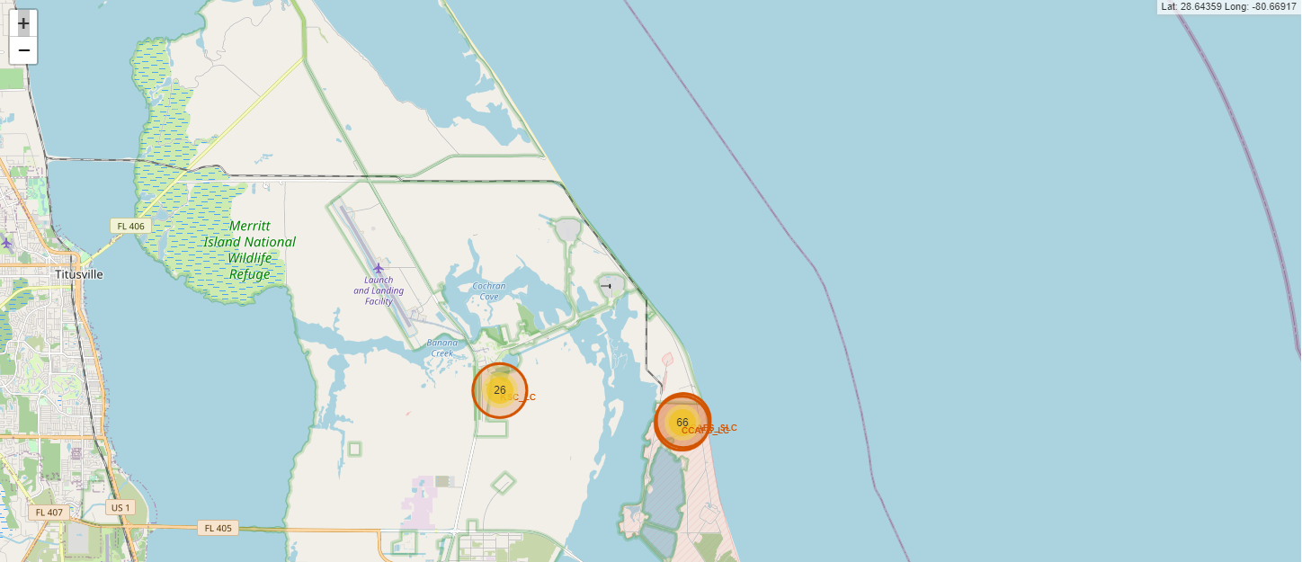
Map with markers, circles with success outcome and coordinates.
This map is the same as the one in the previous slide but it has a functionality that it indicates the coordinates as you move the mouse over the map for giving the instantaneous coordinate ion a specific point if the map.

Slide 44
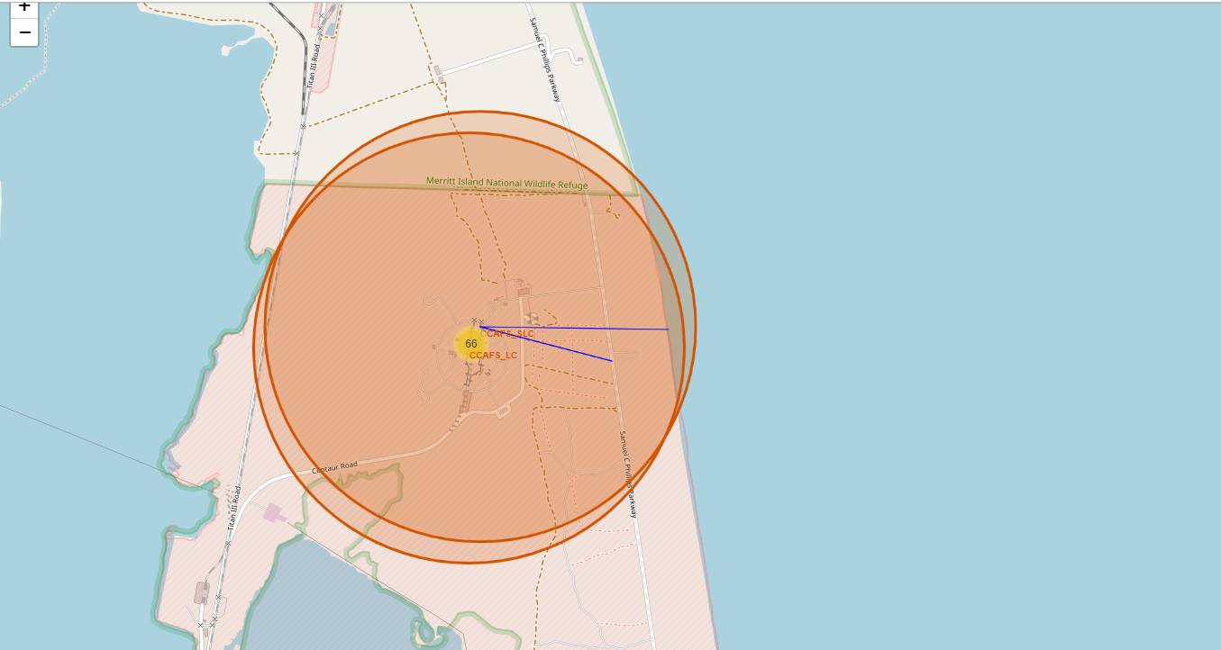
Map with distance lines
The last map has all the functionalities from previous maps but lines with distances are drawn over it that show how long a line is from one point to another to gain insightful information whether if a launch site is close to a road, railroad, shore line, etc.

Slide 45

Section 4

Slide 46
Success Launch for all sites
This pie chart clearly shows which site has the highest and lowest success rates, indicating their percentages.

Slide 47
Payload vs. Launch Outcome scatter plot
This scatter plot shows the correlation between Payload mass and launch outcome. The range slider is very useful because it can filter the payload mass range for a desired one and get instant insightful information.

Slide 48

Section 5

Slide 49
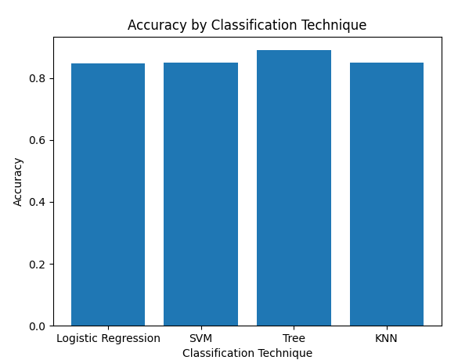
Classification Accuracy
By comparing the accuracy of each model, we found out that the tree classification technique is the most suitable one, even though the others are not far from it.

Slide 50
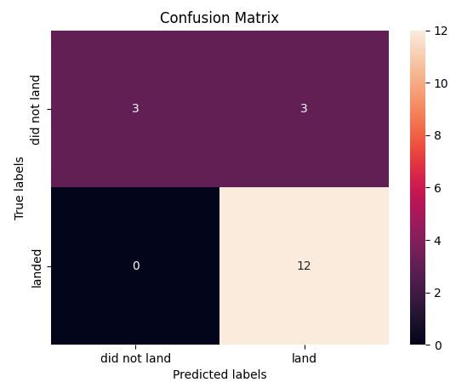
Confusion Matrix
The confusion matrix for the decision tree technique is shown and it reveals that for the actual landed occurrences, the model predicted all the cases and for the not landed actual ocurrences the model predicted half of them.

Slide 51

Conclusions
As the flight number increases, the first stage is more likely to land successfully. The payload mass is also important; it seems the more massive the payload, the less likely the first stage will return.
For the VAFB-SLC launch site there are no rockets launched for heavy payload mass(greater than 10000) and generally speaking for this heavy payload mass there is a high success rate.
With heavy payloads the successful landing or positive landing rate are more for Polar, LEO and ISS. However for GTO we cannot distinguish this well as both positive landing rate and negative landing(unsuccessful mission) are both there here.
The success rate since 2013 kept increasing till 2020.
There was a very high success rate for all missions.
The decision tree technique was the best technique for the model.

Slide 52
Appendix
Below is the link to the several steps for this study:
https://github.com/JulianCarroVerdia/IBM_Data_Science_Capstone_Presentation

Slide 53


